Slide 1


Facial Expression Recognition
Supervisors:
Prof. Boi Faltings
Dr. Claudiu Musat
Georgios Kyritsis

Slide 2
Outline
1. Introduction ___________
2. Main Dataset ___________
3. CNN Architectures ___________
4. Transfer Learning ___________
5. Multi-task learning ___________
6. Facial Action Units ___________
7. Best Architecture – Final Algorithm ___________
8. Conclusion ___________

Slide 3
Introduction

Slide 4
Introduction
Emotion Detection
Emotions
Implement the latest methods to detect and categorize the base emotional state of the people in an image
Neutral, Happiness, Surprise, Sadness, Anger, Disgust, Fear, Contempt

Slide 5
Main Dataset

Slide 6
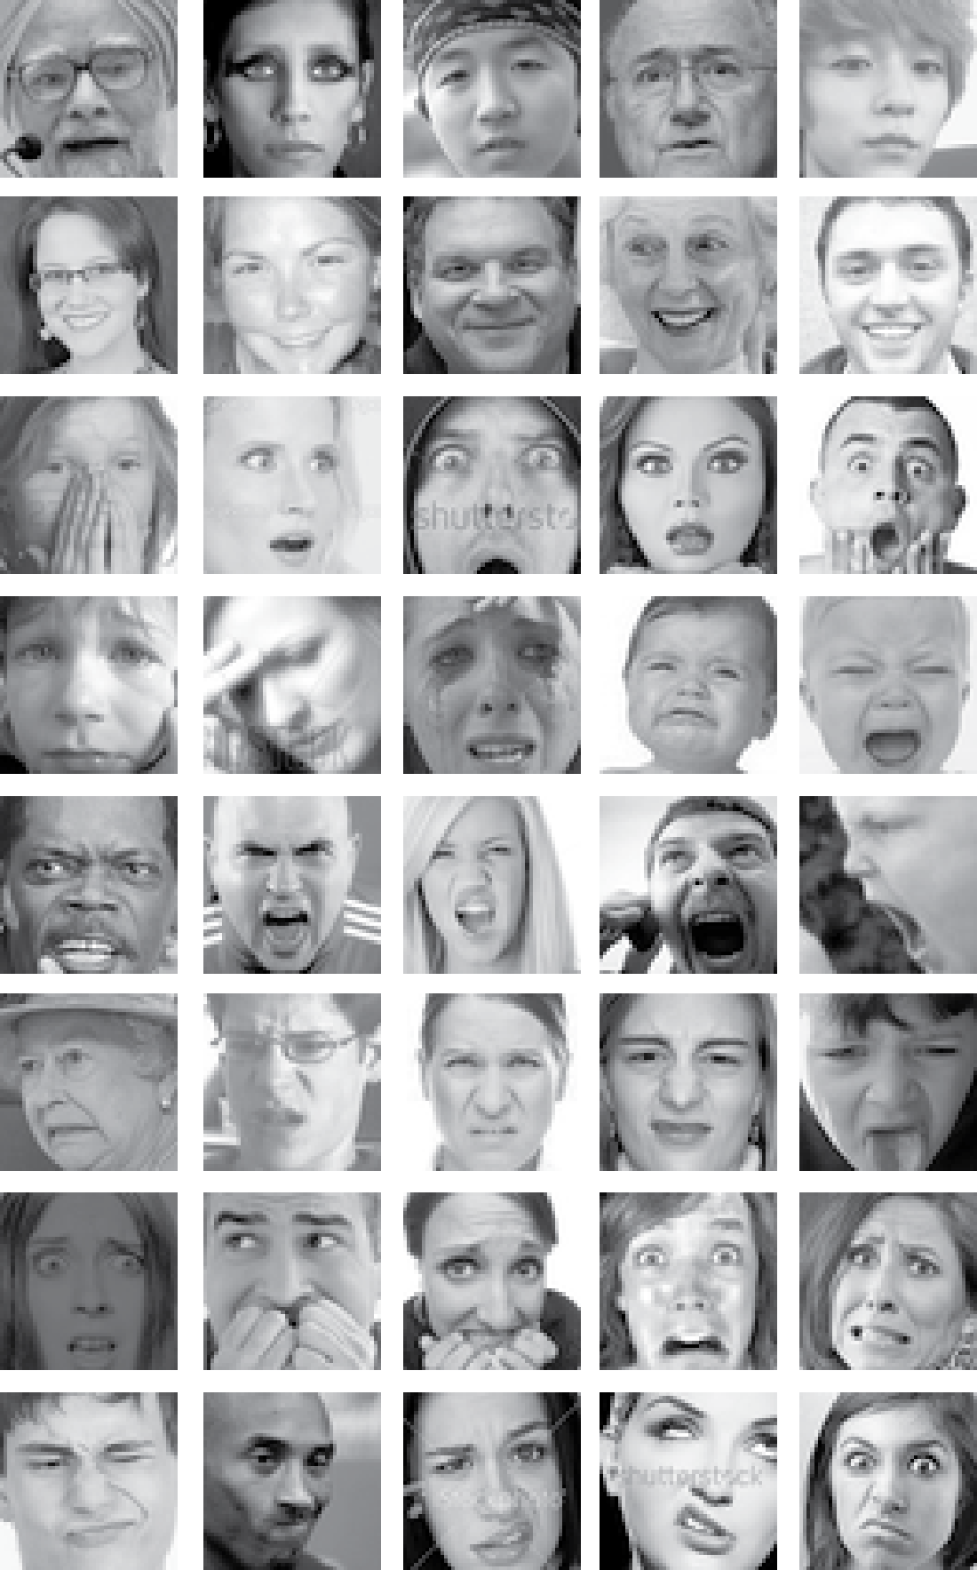
Main Dataset – FER+
Neutral
Happiness
Surprise
Sadness
Anger
Disgust
Fear
Contempt

Slide 7
CNN Architectures

Slide 8
CNN Architectures VGG

Slide 9
CNN Architectures GoogLeNet/Inception

Slide 10
CNN Architectures ResNet

Slide 11
State-of-the-art architecture

Slide 12
Transfer Learning

Slide 13
Transfer Learning

Slide 14
Transfer Learning

Slide 15
Transfer Learning

Slide 16
Multi-task learning

Slide 17
Multi-task learning

Slide 18
Multi-task learning
State-of-the-art architecture

Slide 19
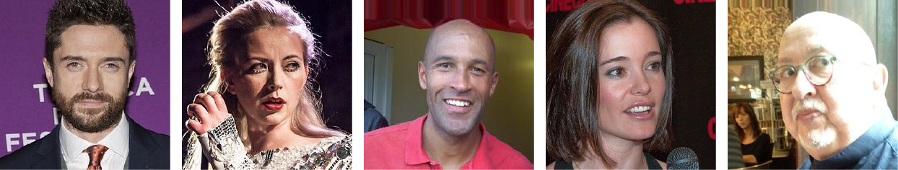
Multi-task learning
IMDB – WIKI

Slide 20
Multi-task learning

Slide 21
Facial Action Units

Slide 22
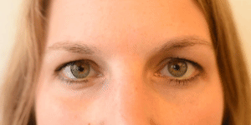
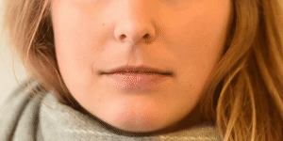
Facial Action Units
AU6 – Cheek Raiser
AU12 – Lip Corner Puller

Slide 23
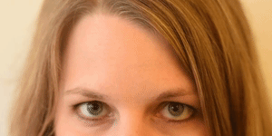
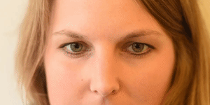
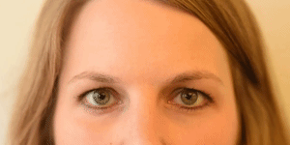
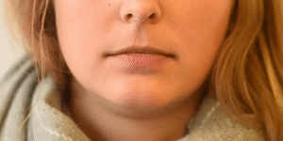
Facial Action Units
AU1
Inner Brow Raiser
AU5
Upper Lid Raiser
AU2
Outer Brow Raiser
AU26
Jaw Drop

Slide 24
Facial Action Units
Cohn - Kanade dataset (CK+)

Slide 25
Best Architecture - Final Algorithm

Slide 26
Best Architecture - Final Algorithm

Slide 27
Conclusion

Slide 28
Conclusion
Final Results
Model | Accuracy
Custom VGG13 | 84.9%
Multi-task learning | 85.2%
Wide ResNet | 86.3%
Wide ResNet + Action Units | 86.6%

Slide 29


Thank you!
Lausanne, March 2018

